Slide 1
Super-Resolution (SRCNN+TL) Model for Ocean Data
Paulo André
October 21, 2024
Super-Resolution (SRCNN+TL)

Slide 2

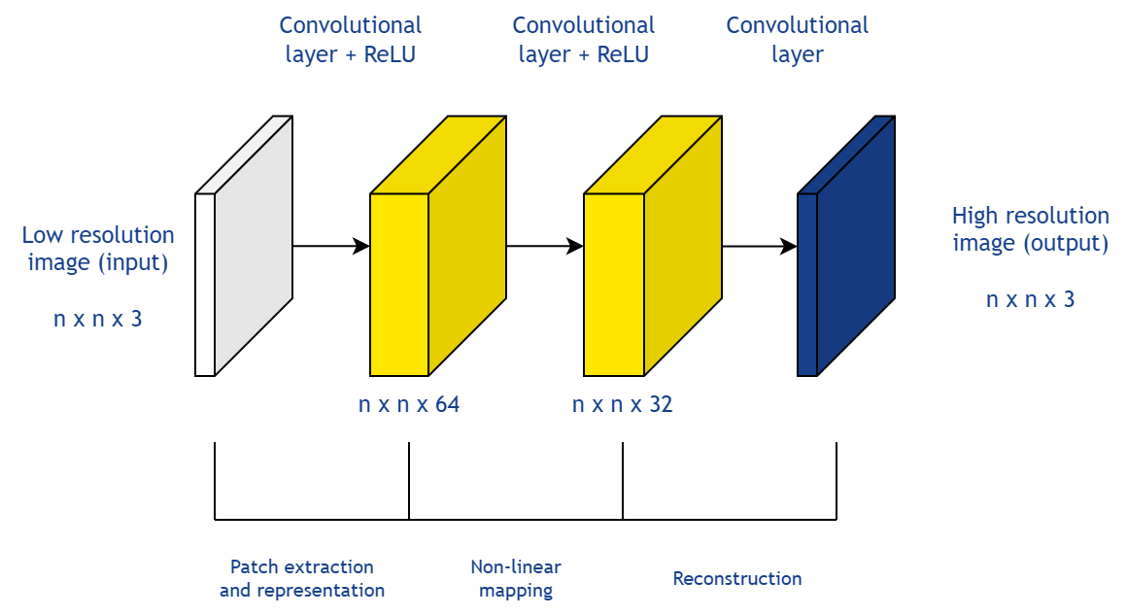
Super-Resolution Convolutional Neural Network
Architecture
Layer 1: Extracts image patches
Layer 2: Non-linear mapping from low-resolution to high-resolution images
Layer 3: High-resolution image reconstruction
Simple structure of a SRCNN model
Advantages
Simplified implementation and understanding
Reduced computational resource requirements
Accelerated output generation
Super-Resolution (SRCNN+TL)

Slide 3
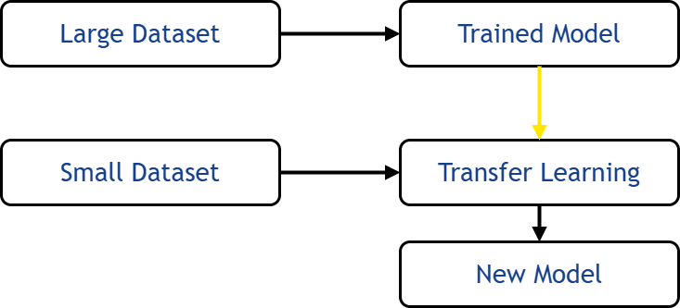
SRCNN allied with Transfer Learning
Main idea
Utilizes a pre-trained model to transfer knowledge from a larger synthetic dataset to the primary neural network
Synthetic Dataset
Base SRCNN model
Real Dataset
Transfer Learning
Application in SRCNN
Base SRCNN model: Trained on synthesized data
New SRCNN model: Gains broader training data and relevant features from the base model
New Model
Super-Resolution (SRCNN+TL)

Slide 4
Quasi-geostrophic simulations of ocean currents
The two-layer quasi-geostrophic (QG) flow is a simplified model used to describe large-scale geophysical fluid dynamics, applied in atmospheric and oceanic simulations. It focuses on two key assumptions:
Quasi-geostrophic approximation – assumes a near balance between the Coriolis force and pressure gradients, allowing for small perturbations in the flow.
Two-layer model – the ocean is divided into two layers of fluid with distinct densities. The upper layer represents lighter fluid, and the lower layer represents denser fluid.
Super-Resolution (SRCNN+TL)

Slide 5
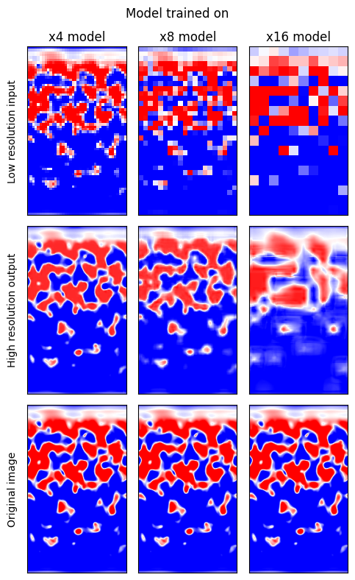
Results and Metrics
 | MSE LR and HR | MSE Output and HR | SSIM LR and HR | SSIM Output and HR
psi2 x4 | 0,002168 | 0,000587 | 0,944597 | 0,983848
psi2 x8 | 0,010996 | 0,005188 | 0,862397 | 0,916204
psi2 x16 | 0,026366 | 0,016956 | 0,789501 | 0,811492
 | Ek LR and HR | Ek Output and HR | ACC LR and HR | ACC Output and HR
psi2 x4 | 8,559898 | 3,493588 | 0,961298 | 0,994925
psi2 x8 | 20,581617 | 11,859362 | 0,748969 | 0,937298
psi2 x16 | 32,148914 | 23,487898 | 0,487231 | 0,705036
Super-Resolution (SRCNN+TL)

